Slide 1

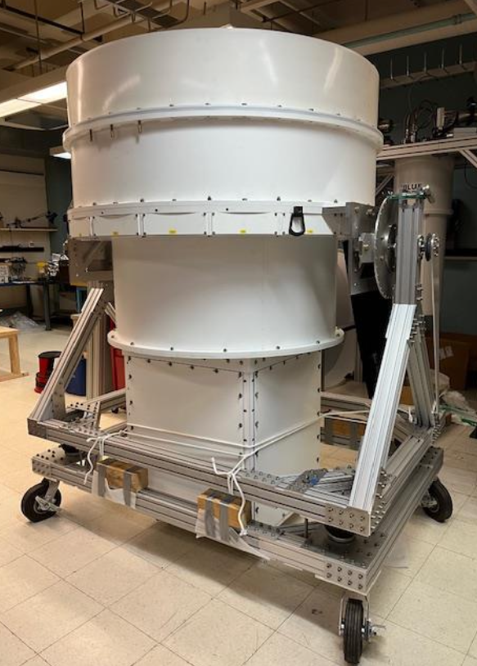
ALPACA at HCRO

Slide 2
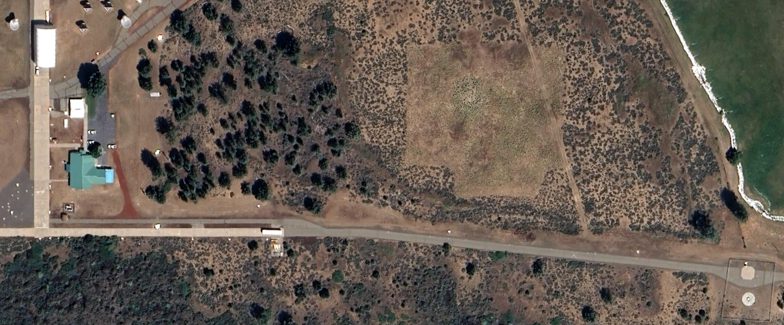

Fiber cable run:
all underground in 3 inch conduit
from Lab 1 to feed location 530 meter
total length including spare 580 meter
DSP location
Main Office
Feed /Dome location

Slide 3
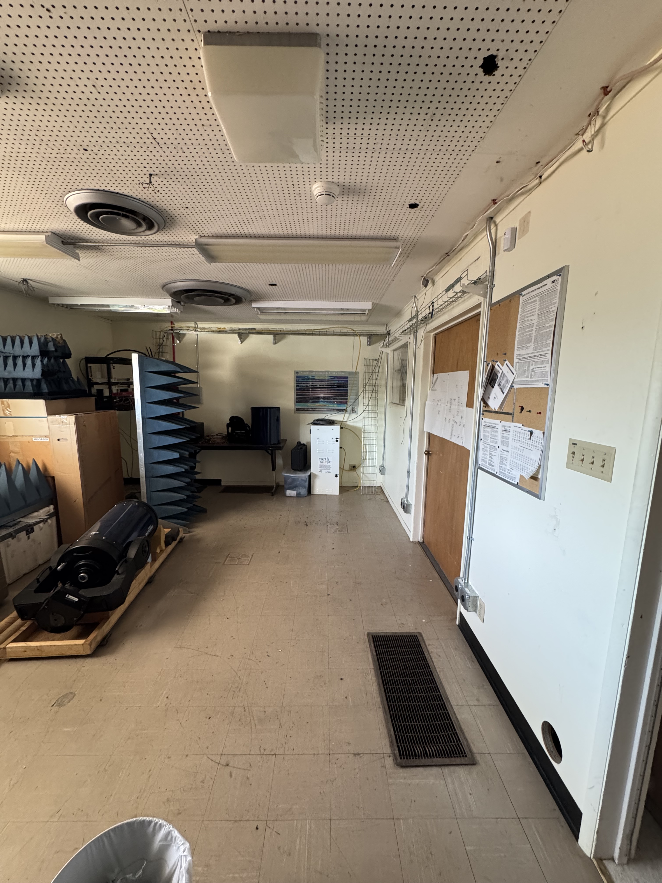
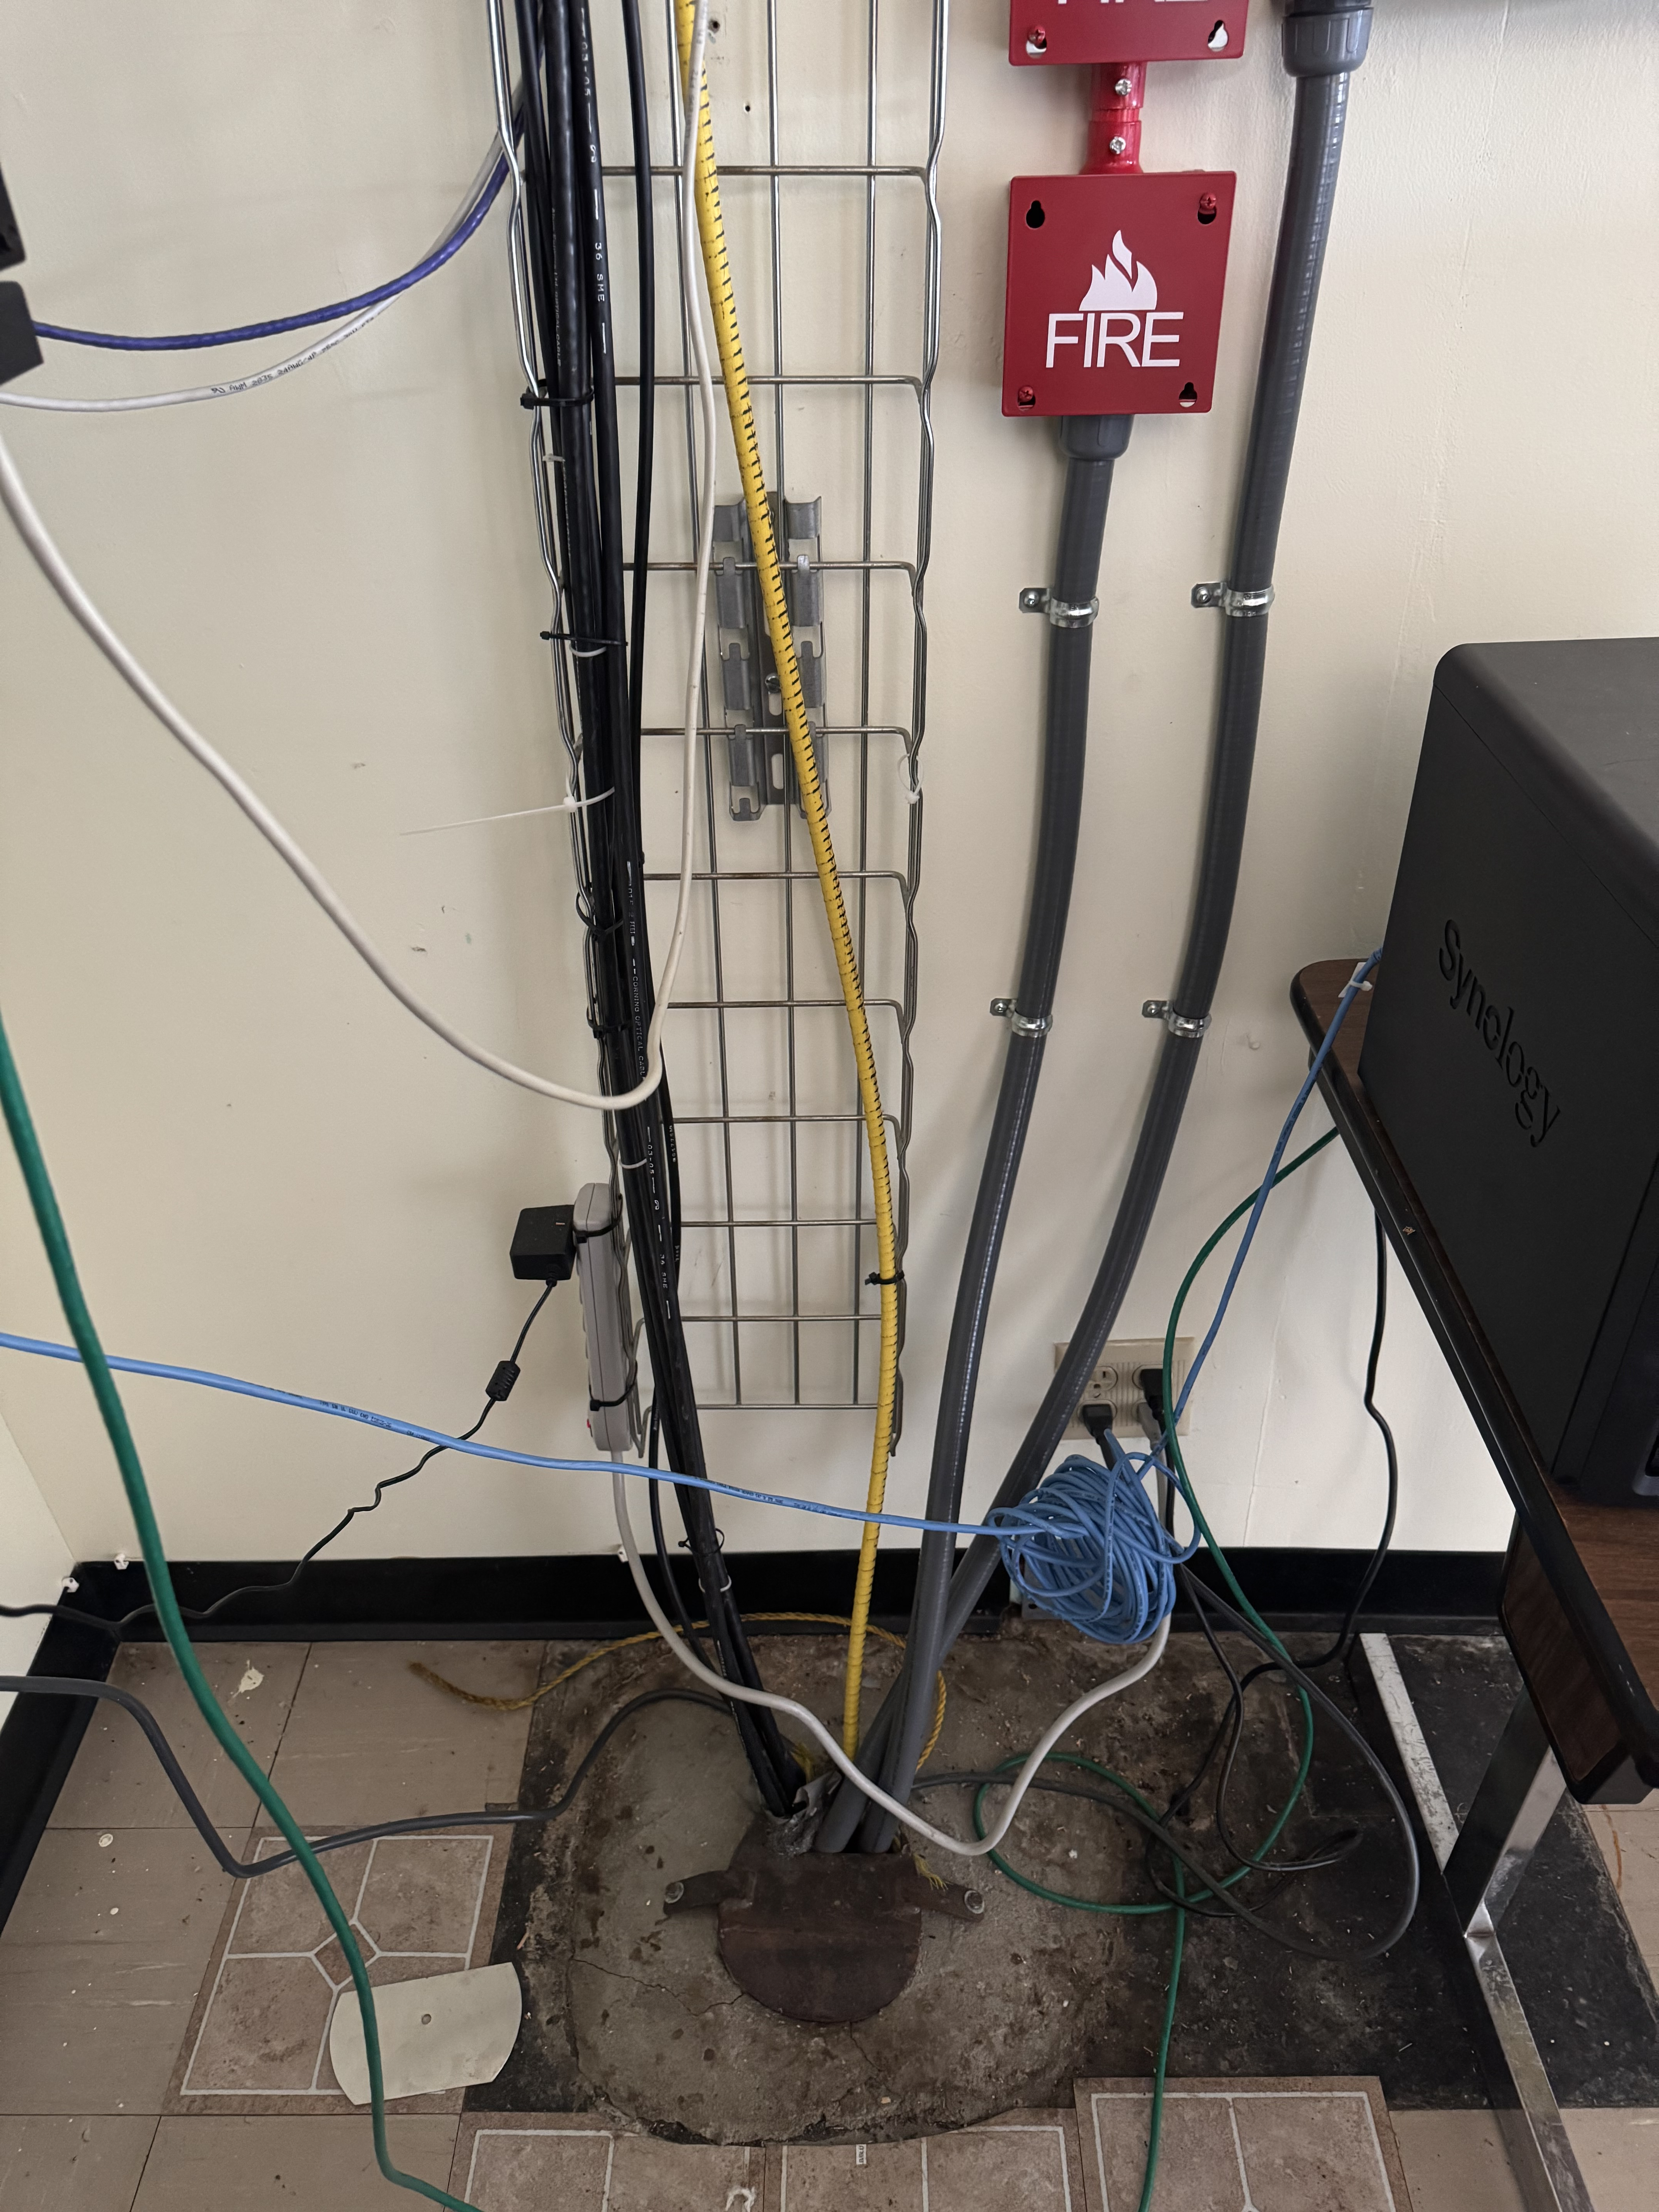
DSP Location:
planned AC capacity 8 ton
hot and cold isle (left side cold, right side hot)
6x L6-30amp outlets already installed
L6-30 outlets
Fiber conduit
Rack location

Slide 4
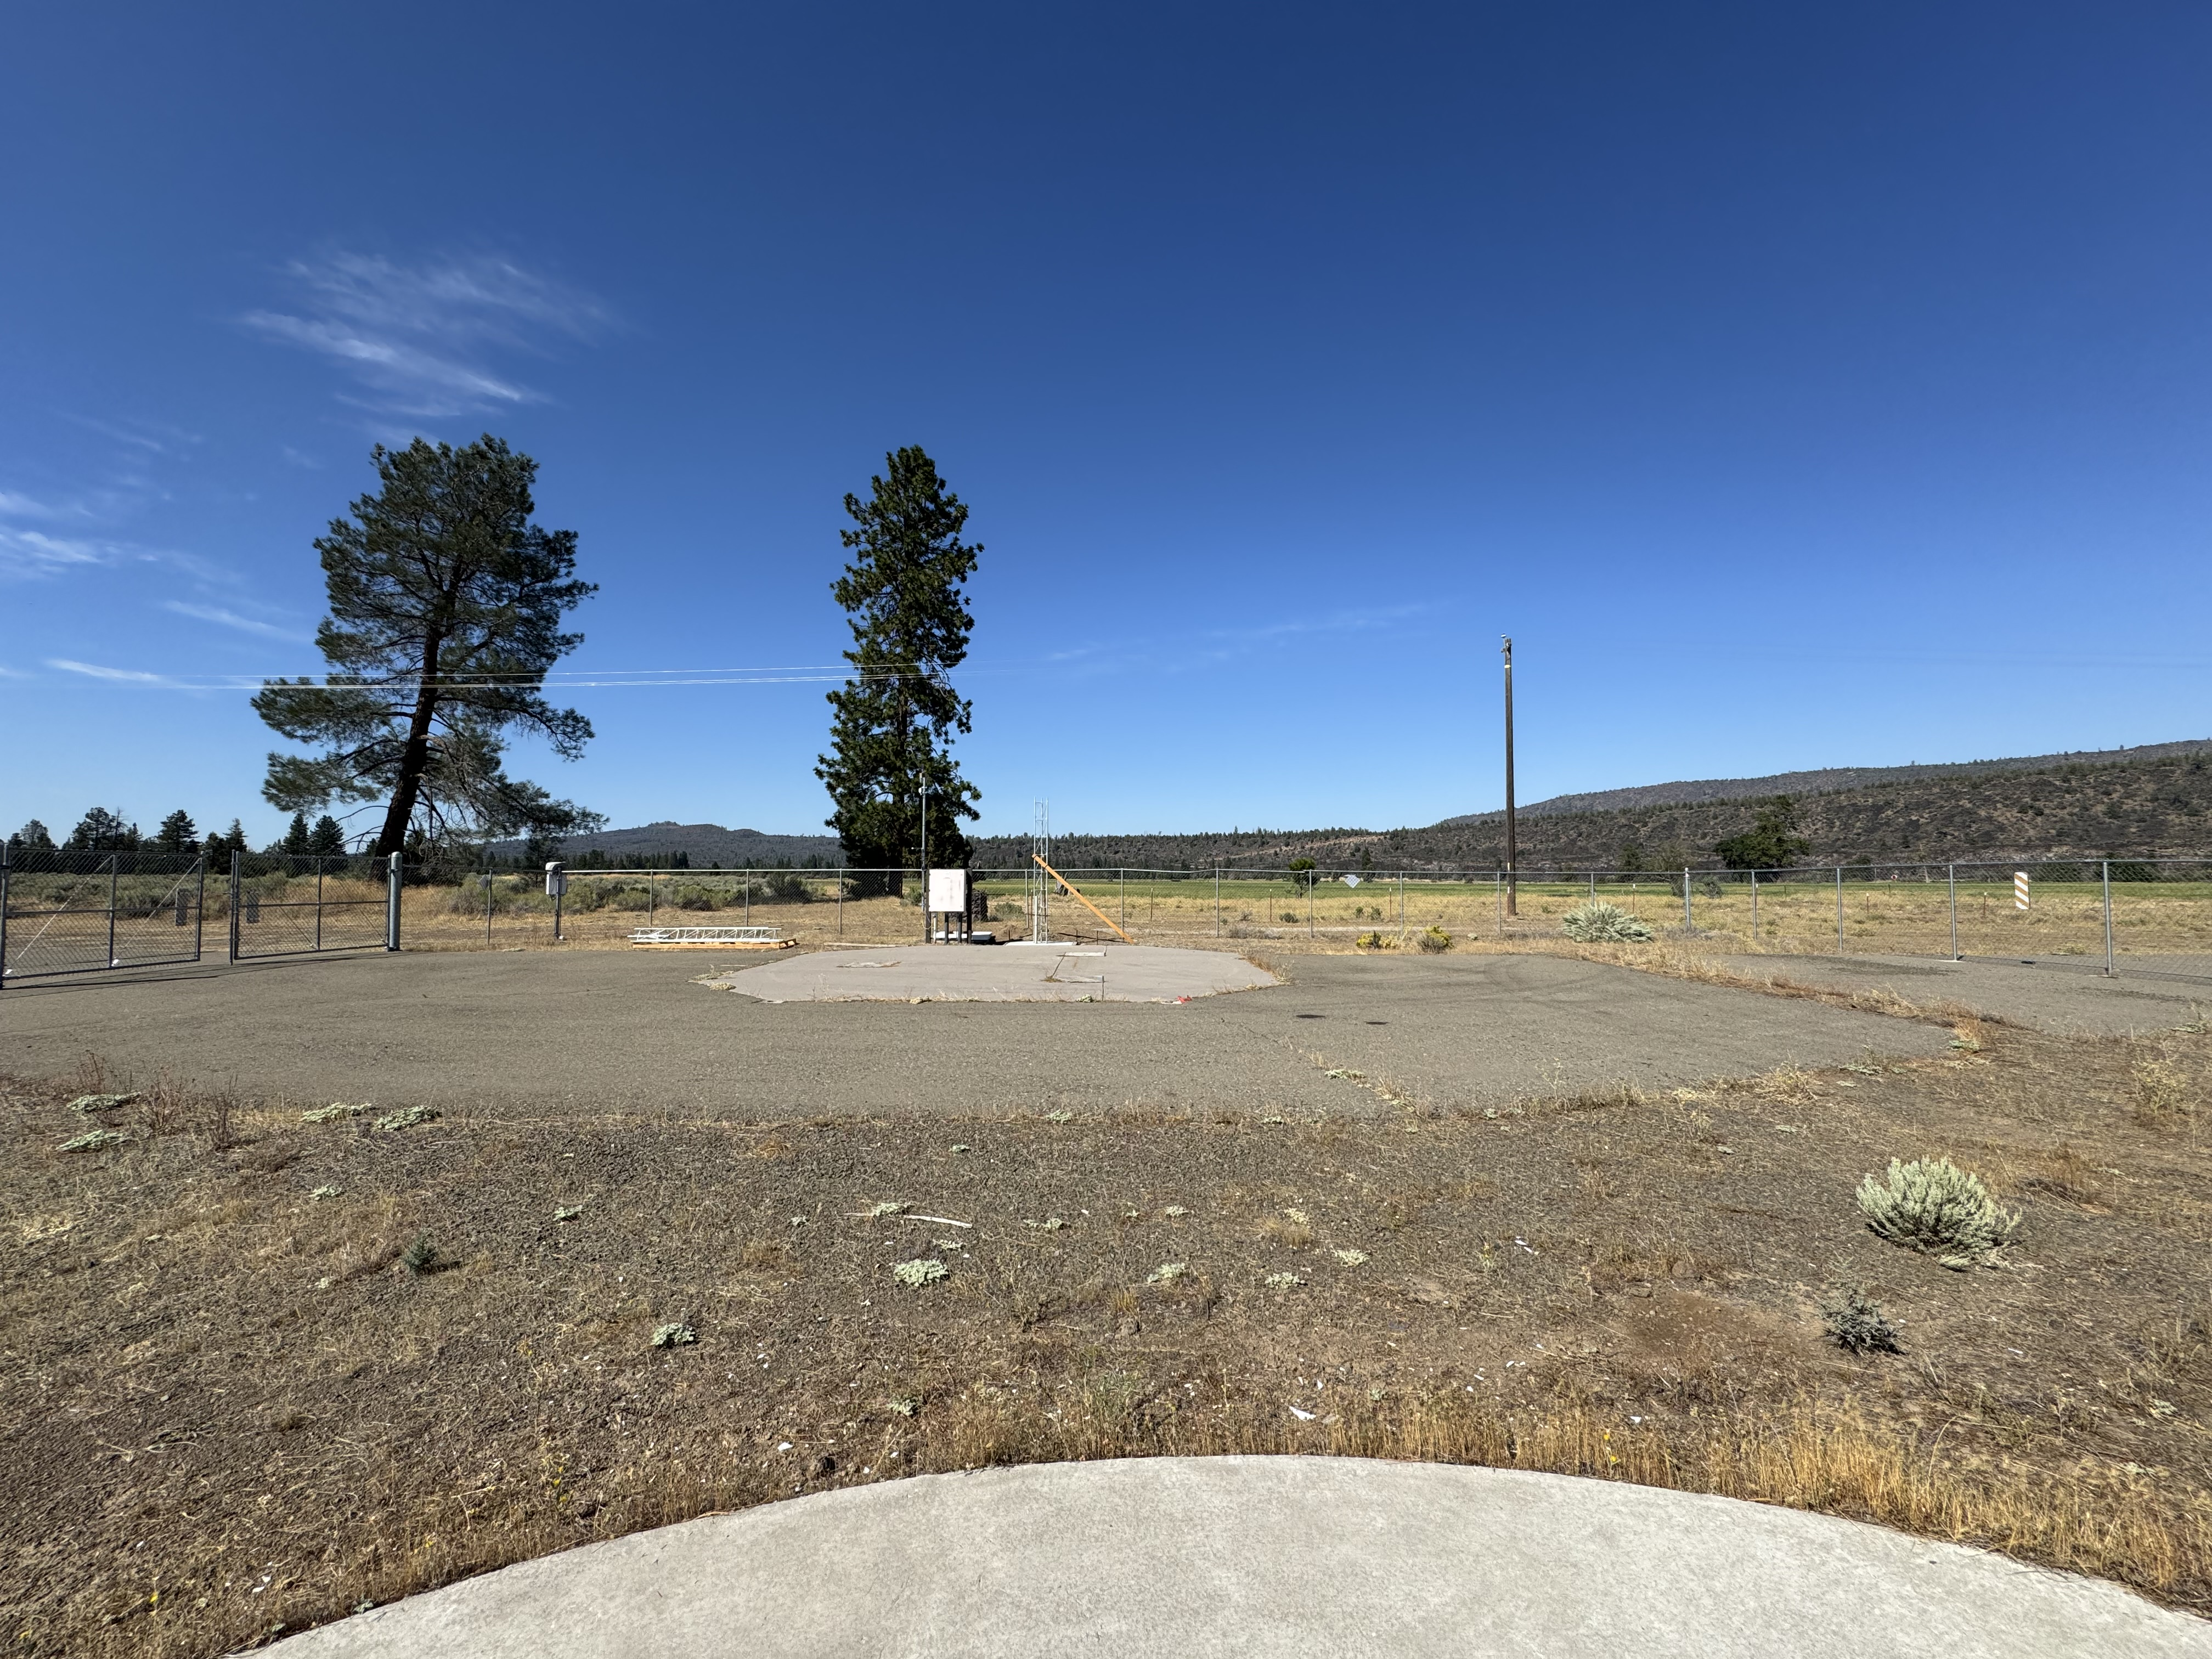
Feed Location:
3phase 480V and 120/208V
planned to set up new shed
planned to have radome for feed
Shed location to house feed
Power & Fiber
Dome

